Slide 1
Results Sections

Slide 2
Basic APA rules
12 point font
Times New Roman
1 inch margins
Double spaced

Slide 3
Results section rules
Centered “Results” first line
Just hit enter, no double double space
2 decimal places
Statistical abbreviations are italicized
t, F, p, M, SD

Slide 4
Descriptives
Descriptive statistics always go first.
Mean = M
Standard Deviation = SD
Standard Error = SE
Most common thing to list is the Mean and Standard Deviation
For each group or variable or those combinations.

Slide 5
Descriptives
If there are a lot of variables, you can make a table or chart
Usually depends on the data…
Do not spell out numbers.
Do not abbreviate variable names (aka it needs to be in English!).

Slide 6
Inferentials
Then you list the test you performed:
ANOVA (be sure to list the type)
T-test (type!)
Chi Square
MANOVA

Slide 7
Inferentials
Tell if the test was significant or not, but in terms of your question.
The dual task group was not significantly different from the single task group.
The college student average was significantly below the normal average.

Slide 8
Inferentials
In the same sentence you listed the significance of your test, you will list the associated values.
T-tests look like this:
t(degrees of freedom) = t-number, p= p-value.
t(47) = 4.75, p=.02

Slide 9
Inferentials
F-tests
F(df between, df within) = f number, p= p value
F(1,35) = 12.35, p=.001
Correlation
r = correlation, p = p-value
r = .45, p<.001

Slide 10
Inferentials
Chi Square
X² (degrees of freedom) = chisquare, p = pvalue
X² (35) = 265.50, p=.05
Other common ones:
Beta = β
Regression variance = R²

Slide 11
Presenting Data in Graphic Form

Slide 12
Types of Figures
Tables
Graphs
Line
Scatter
Bar

Slide 13
Tables
Table 1. Table Title Goes Here.
 | Y variables | Y variables
X Variable | Number | Number
X variable | Number | Number
X variable | Number | Number
Statistics | F, t, p | F, t, p
Note. Some other important information goes here.

Slide 14
Line Graphs
Use?
When variables are continuous
Continuous variable = variable which intermediate values exist (i.e. it’s not categorical)
X variable on Horizontal axis
Y variable on vertical axis

Slide 15
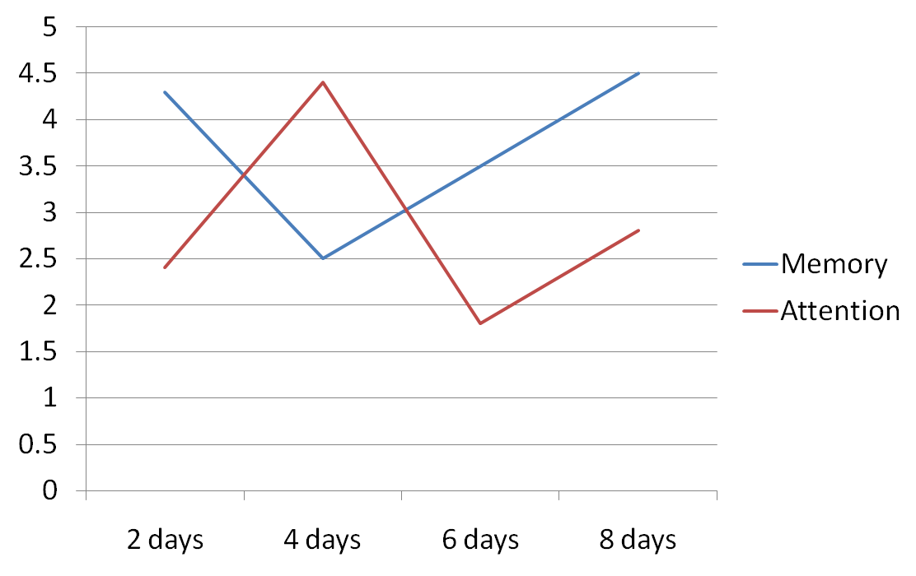
Line Graphs
Test Score in Percent
Retention Interval
Figure 1.

Slide 16
Scatter Plots
Use?
When you are using a correlation/regression analysis.
Data points are people not averages.
Same rules as line graphs.

Slide 17
Scatter Plots
Test Score in Percent
Retention Interval
Figure 1.

Slide 18
Bar Graphs
Use?
When variables are discrete – or categorical
Tests with groups
ANOVA, T-test, MANOVA, etc
IV on X-axis
DV on Y-axis

Slide 19
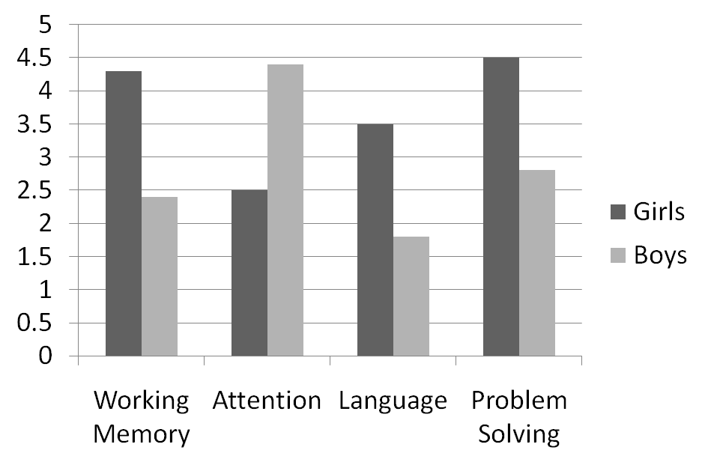
Bar Graphs
Test Score in Percent
Test Type
Figure 1.

Slide 20
Figures
Each one gets its own page
No header/page number
Make sure the figure is labeled

